Slide 1
COMP6049 – Algorithm Design and Analysis
Topic 22 – Branch and Bound

Slide 2
Outline Materials
Definition of branch and bound
FIFO branch and bound
LIFO branch and bound
LC branch and bound
Solving traveling salesman problem

Slide 3
BRANCH AND BOUND
Branch and Bound method is an algorithm technique especially studies how to reduce Search Tree as small as possible.
Steps:
Branch builds all branches of a tree that are possible to be the solution.
Bound calculates which node is an active node (E-node) and which nodeis a dead node (D-node) using constraints.

Slide 4
BRANCH AND BOUND TECHNIQUE
FIFO Branch and Bound
Branch and Bound technique that uses queue for calculating Branch and Bound by First In First Out.
LIFO Branch and Bound
Branch and Bound technique that uses stack for calculating Branch and Bound by Last In First Out.
Least Cost Branch and Bound
This technique calculates cost for each node. Node that has the smallest cost supposed as having the biggest probability to be the solution.

Slide 5
SOLVING PROBLEM USING BRANCH AND BOUND
Branch and Bound can be used to solve some problems using Search Tree
Traveling Salesman Problem
N-Queen Problem
15 Puzzle Problem
0/1 Knapsack Problem
Shortest Path

Slide 6
FIFO BRANCH AND BOUND
Use queue
Enter E-node into a queue, then build the next branch.
D-node is not used to build the next branch.
Get Partial Space Tree that is searched.

Slide 7
LIFO BRANCH AND BOUND
Use stack.
Enter E-node into a stack, then build the next branch.
D-node is not used to build the next branch.
Get Partial Space Tree that is searched.

Slide 8
LEAST COST BRANCH AND BOUND
On the FIFO and LIFO technique, the node is opened in this order
In Least Cost Branch and Bound, nodes having the lowest cost first opened (the next E-node)
At a node x is applicable b ≤ c(x) ≤ u
b is the lower limit
c(x) is the cost of the node x
u is the upper limit
If b>u then the node x can be turned off (expressed as D-node).

Slide 9
EXAMPLE OF LC BRANCH AND BOUND
Traveling Salesman Problem can be solved using the Least Cost Branch and Bound
Steps:
Describe the problem with weighted graph G = {V, E}
C (i, j) = value (cost) on the edge <i,j>, where C (i, j) = ∞, if there is no edge between i and j.
By the definition of value (cost) above, up Cost Matrix of the TSP.
Perform the reduction of the Cost Matrix, obtained Reduced Cost Matrix.
Use the barrier function (bound), to build the Search Tree from the Reduced Cost Matrix.
And so on to obtain a desired set of solutions.

Slide 10
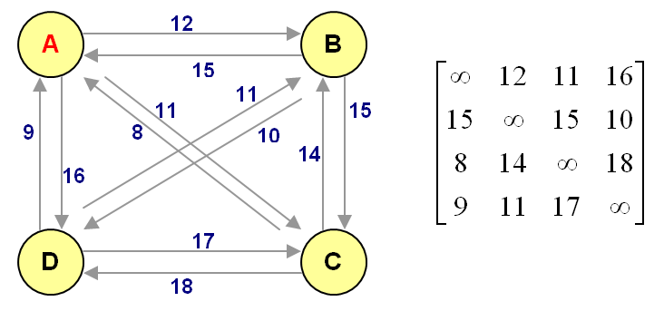
EXAMPLE CASE
Same case at the meeting of 16 re-used to be solved by Branch and Bound

Slide 11
TSP USING BRANCH AND BOUND
Steps:
Describe the problem with weighted graph G = {V, E}
C (i, j) = value (cost) on the edge <i,j>, where C (i, j) = ∞, if there is no edge between i and j.
By the definition of value (cost) above, build Cost Matrix of the TSP.
Perform the reduction of the Cost Matrix, obtained Reduced Cost Matrix.
Use the barrier function (bound), to build the Search Tree from the Reduced Cost Matrix.
And so on to obtain a desired set of solutions.

Slide 12
EXAMPLE CASE
Same case at the meeting of 16 re-used to be solved by Branch and Bound

Slide 13
REDUCED COST MATRIX
For each row, find the smallest value, indicate with c (i). Reduce all values ​​in that row with c (i).
For each column, find the smallest value, indicate with c (j). Reduce all values ​​in that column with c (j).
Add up the total of all values ​​c (i) and c (j) to be the value of R (total reduction). This value is the total value of successfully reduced.

Slide 14
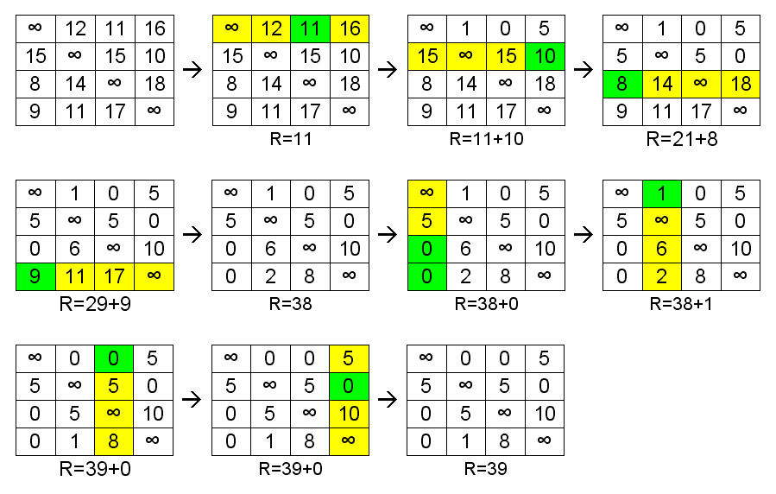
RCM CALCULATION

Slide 15
SEARCH TREE TSP USING BRANCH AND BOUND
Characteristics of Search Tree:
At a node x applicable b ≤ c (x) ≤ u
b is the lower limit
c(x) is the cost of the node x
u is the upper limit
In case b>u then the node x can be turned off (expressed as D-node)

Slide 16
STEPS TO BUILD SEARCH TREE
At the Space Tree begins, the value of b for the root node is the R value for RCM root node. The value u is ∞.
Every time a new E-node is opened, the RCM will be calculated for these nodes.
How to create a new RCM for the node (i,j):
The new RCM is created by RCM of the parent node
Give the red color on the element at position (i,j)
Change all values in row i to ∞, give the blue color
Change all values in column j to ∞, give the blue color
Change the element in position (j, 1) to be ∞, give the color purple
Perform matrix reduction, add entire the reduced values to the R value.

Slide 17
STEPS TO BUILD SEARCH TREE (Cont.)
4. With the calculated RCM, then it can be calculated b value for the root using the formula:
b(i,j) = b(parent) + c(i,j) of parent RCM + R(new RCM)
c(i,j) is value of (i,j) element of RCM parent (its location is marked with green color in the new RCM)
5. Based on all E-nodes that it has been calculated its RCM, choose one that has the smallest cost b (Least Cost B & B). The selected node will be opened and generate new E-node. This process is the process of Branch.
6. When the most bottom of E-node opened (found candidate solution), then the u value is set to the b value of the bottom node. Then checked whether the next smallest b value of the entire tree is less than u value. All the E-node has a value of b > u is expressed as D-node. Process of making Space Tee is continued from the remaining E-node. This is process of bound.
7. If do not exist, then the path from the root to the E-last node is the solution being sought. B of the lowest cost node is the path length TSP sought.

Slide 18
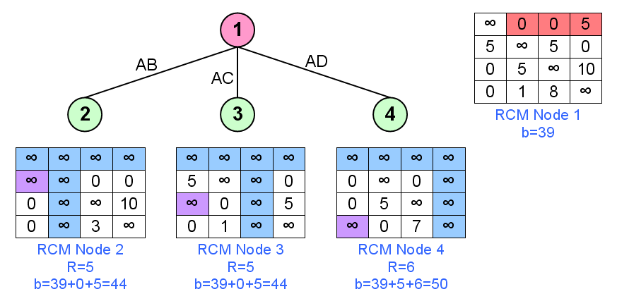
TSP USING B&B (1)

Slide 19
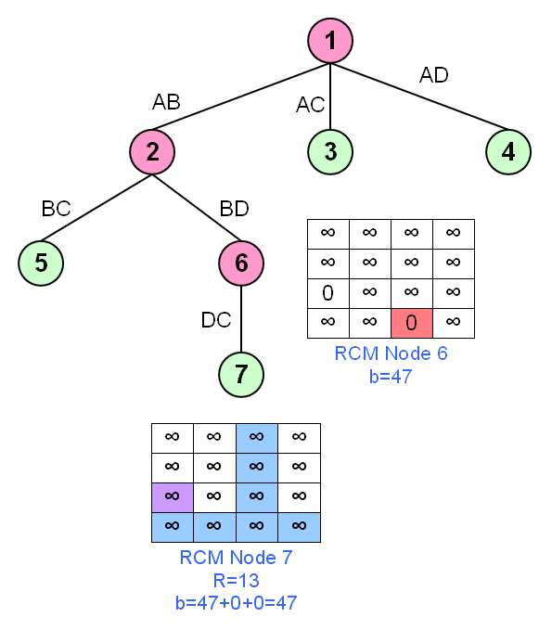
TSP USING B&B (2)

Slide 20
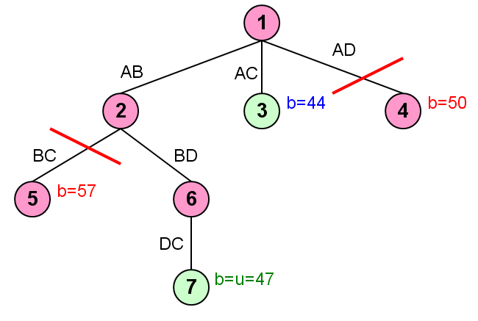
TSP USING B&B (3)

Slide 21
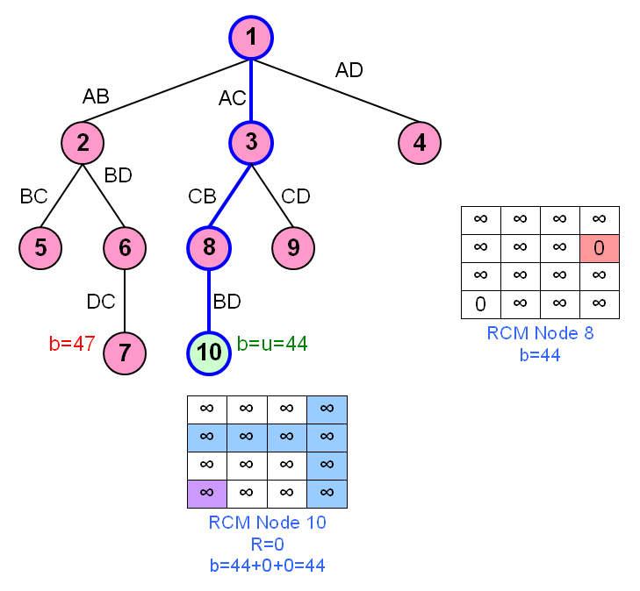
TSP USING B&B (4)
[buku utama, ilustrasi 9.29]

Slide 22
EXERCISE
Explain advantages and disadvantages of Branch and Bound technique!

Slide 23
EXERCISE
A salesman plans to travel to several places where the distance between two places are given as follows:
If the salesman departs from A, and he wants to pass each place only once and return to A, please determine the shortest path for his travel using Branch and Bound method
From | To | Distance (km)
A | B | 6
A | C | 2
B | A | 5
B | D | 5
C | A | 4
C | B | 3
C | D | 3
D | A | 4
D | C | 7

Slide 24
EXERCISE
Given a Cost Matrix Graph TSP as follows:
Draw the graph of the TSP!
Find the shortest path TSP using Branch and Bound!

Slide 25
REVIEW
Branch and bound technique
FIFO branch and bound
LIFO branch and bound
Least cost branch and bound
Solving problem using branch and bound
TSP as an example of least cost branch and bound

Slide 26
REVIEW
TSP using branch and bound
Reduced cost matrix
RCM calculation
Search tree TSP using branch and bound
Steps to build search tree
TSP using branch and bound

Slide 27
Q & A

Slide 28
References
S. Sridhar. 2014. Design and Analysis of Algorithms, 1/e. Oxford University Press. India. Chapter 15
Ellis Horowitz,Sanguthevar Rajasekaran,Sartaj Sahni. 1998. Computer algorithms/C++. 1STBL. New York. Chapter 8.1 & 8.3
Branch and Bound http://www.devarticles.com/c/a/Development-Cycles/Branch-and-Bound-Algorithm-Technique/

Slide 29
THANK YOU

